Slide 1
Using Weather Variability to Estimate the Response of Savings to Transitory Income in Thailand
Christina H. Paxson
JEL D91, O16
Presented by Jingyi Fang
ECON 541

Slide 2
Problem of Interest
The extent to which farmers are able to use savings and dissavings to smooth consumption in response to unexpected shocks to income.
Fluctuations in farm incomes will lead to changes in the consumption of farmers only if the savings behavior of farm households does not offset income fluctuations.
How the savings behavior of Thai farm households is related to transitory income.
Estimate marginal propensities to save out of transitory income: a finding that these marginal propensities are high would indicate that farmers do use savings to smooth consumption.

Slide 3
Challenge of the papers
The difficulty of decomposing income into transitory and non-transitory (permanent) components, unobserved variables.
The author use time-series information on regional rainfall in conjunction with cross-sectional data on farm household income to obtain estimates of that component of household income due to shocks in regional rainfall.
Savings are hard to measure since income is severely underreported relative to expenditure, fake low savings.
The author correct a portion of the apparent downward bias in the savings measures due to inflation, savings are reported in a short time frame before the survey but income is reported as annual income or long-period term.

Slide 4



A permanent-income model of savings
Permanent income is defined over a short time horizon, as expected income for year t conditional on the resources (and information) of the household at the beginning of the period.
The savings of household i in region r at time t is a linear function of permanent income (Y_{irt-P}), transitory income (Y_{irt-T}), and the variability of the household’s income (VAR_{ir}) and life cycle factors W_{irt}, consisting of the number of household members.
Transitory income is the difference between realized and expected income.
The variance of income can be obtained by maximizing a lifetime utility function that is additively separable over time and has either a quadratic or a constant-absolute-risk-aversion (CARA) form, given that the household’s income stream is normally distributed.
The propensity to save out of permanent income should be close to 0 and the propensity to save out of transitory income should be close to one.

Slide 5



Construct models to gain permanent income and transitory income measures
Permanent income is a function of household specific variables (six dummies: amount of land owned by the household and the number of household members in 13 age/sex/eudcation categories), regional fixed effect, year effect.
Transitory income is a function of region-specific variables (deviations from average values of regional rainfall in each of four seasons), year effect. No information about household-specific variables that affect transitory income is available, so those variables are included in the error term.
Add (2) and (3) to get the total income, and substitute into (1) and get the savings:
VAR and W are colinear with determinants of permanent income.

Slide 6
Data
The 1975/76, and 1986 Socio-Economic Surveys (SES) collected detailed information on income by source and on expenditure by commodity type for samples of Thai households.
There are three ways to measure savings:
SAVE1 defined as the difference between income and expenditure on all goods and services, may understate savings because expenditure on durables has a flow instead of being consumed upon purchase;
SAVE2 defined as the difference between income and expenditure on all goods and services except consumer durables, overestimates true savings;
SAVE3 defined as purchases minus sales of real and financial assets in the month before the survey, may have serious measurement problems, since purchases and sales of such things as farm animals and equipment are not explicitly measured.

Slide 7


Data
Correcting saving figures for inflation bias since the survey asked about expenditure during a short time period before the survey but income during a longer time before the survey.
The author deflated all “monthly” expenditure items using a monthly consumer price index obtained from the International Financial Statistics data tape and then recalculated the savings measures using deflated expenditure
The rainfall measures were used to construct four basic weather variables representing different crop seasons. R1 measures total rainfall (mm) during Jan-Mar, agricultural off-season; R2 measures rainfall during Apr-Jun and covers the planting season; R3 measures rainfall during Jul-Sep and runs through the growing season; R4 measures rainfall during Oct-Dec and covers the harvest.
Deviations of rainfall (R_{j} – R_{j-bar}), denoted STD.DEV(R_{j}), were used as the measures of rainfall variability in VAR_{ir}

Slide 8
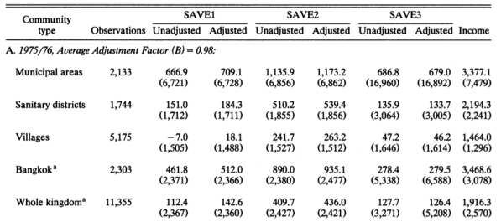
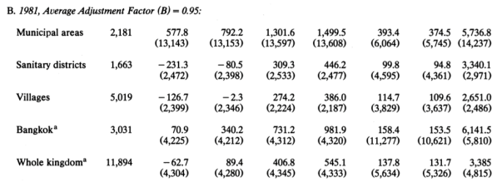
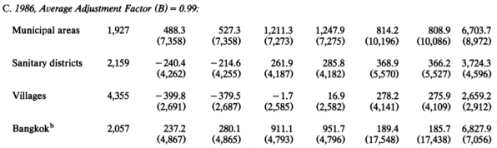
Results
After adjusting the bias due to inflation, the adjusted savings are much greater than unadjusted savings.
SAVE3 is not biased by inflation, however, it is measured as changes in assets in the month before the survey inflation during the survey period will attenuate the observed relationship between the fraction of income saved and income. For this reason, it is also adjusted.
Annual inflation of consumer prices in Thailand averaged approximately 16% over 1980 and 1981, 5% over 1975-1976 and 2% for 1986, therefore, the adjustment can make a big difference.

Slide 9
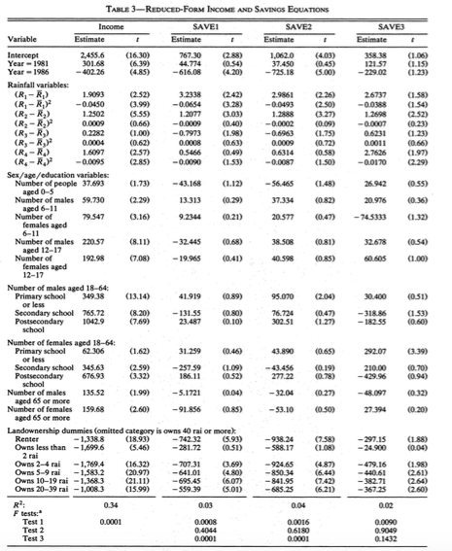
Results by two-step procedure
The income equation indicates that if R2 turned out to be 127.93 millimeters above its average level, monthly income would increase by 175 baht.
This effect is fairly large, given that average monthly income is 1355 baht.
The effect of increase in rainfall on income for R3 and R4 is very little.

Slide 10
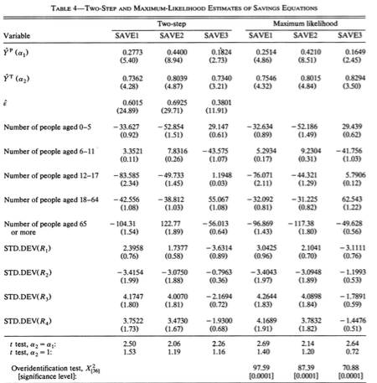
Farmers save a high fraction of transitory income, the propensities to save out of transitory income range from 0.73 to 0.83.
For all savings measures, the saving propensities out of transitory income are significantly different from the lower propensities.
The propensity to save out of permanent income is higher for SAVE2 than SAVE1, SAVE3 is associated with the lowest propensity.

Slide 11
Discussion
This study implies that propensities to save out of transitory income due to rainfall shocks are high; important because households use savings to buffer consumption from income shocks.
What about other income shocks other than rainfall? For example, transitory declines in world rice prices lead to large decreases in savings but a tax on rice exports that permanently lowers the rice price has a much smaller effect on savings, so results might be different with different reasons of income shocks.
Households may face borrowing constraints if income declines are very large and the savings are not enough to buffer the shocks. What would happen to the propensity to save out of permanently income?
The use of regional time-series data to identify a component of transitory income is amazing.
This paper fails to find an instrument that affects only income but does not directly affect consumption to eliminate endogeneity.

